Slide 1


Consumer Goods Ad Hoc Insights
TLIQ HARDWARE
By Yash Baviskar

Slide 2
Introduction
Atliq Hardware is one of the leading computer hardware producers in India and well expanded in other countries too. The management noticed that they do not get enough insights to make quick and smart data-informed decisions.
They want to expand their data analytics team by adding several junior data analysts. Tony Sharma, their data analytics director wanted to hire someone who is good at both tech and soft skills. Hence, he decided to conduct a SQL challenge which will help him understand both the skills. The challenge has following task There are total 10 ad-hoc requests which needs to be answered.

Slide 3
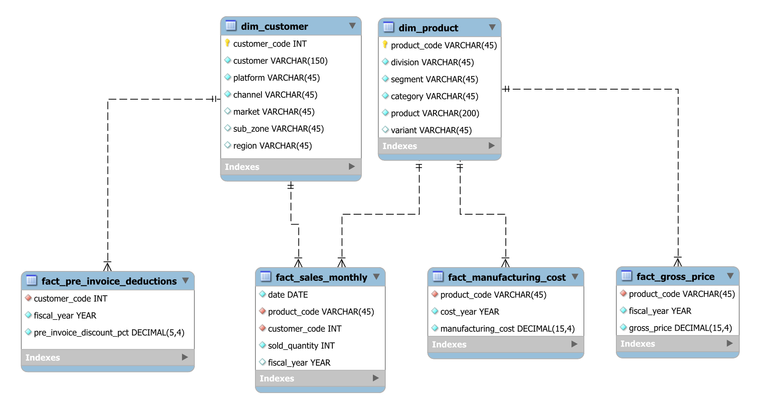
The schema of the database used for analysis

Slide 4
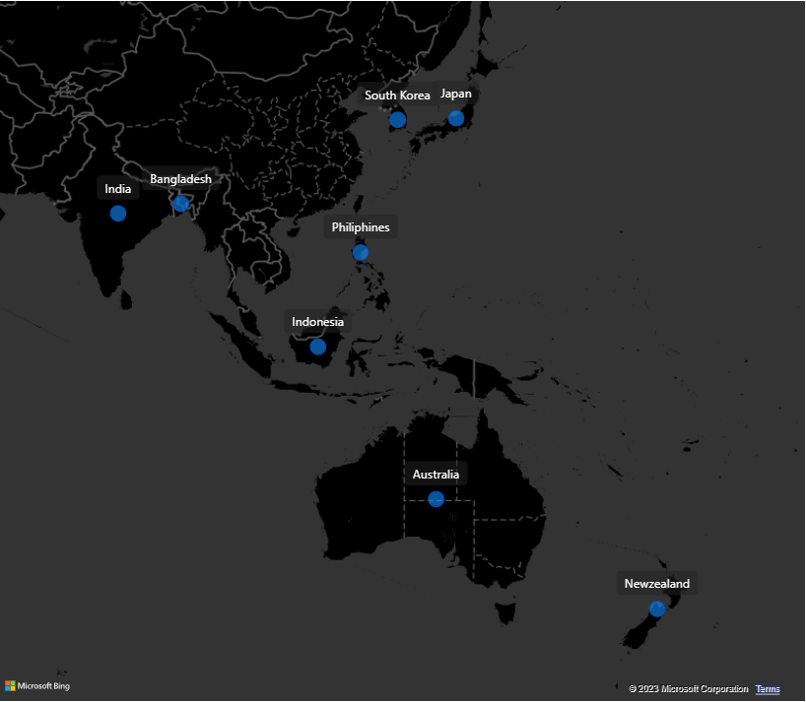
1.Provide the list of markets in which customer "Atliq Exclusive" operates its business in the APAC region.
Atilq operates business in following APAC Region Countries
India
Bangladesh
Philippines
Indonesia
Australia
New Zealand
South Korea
Japan

Slide 5
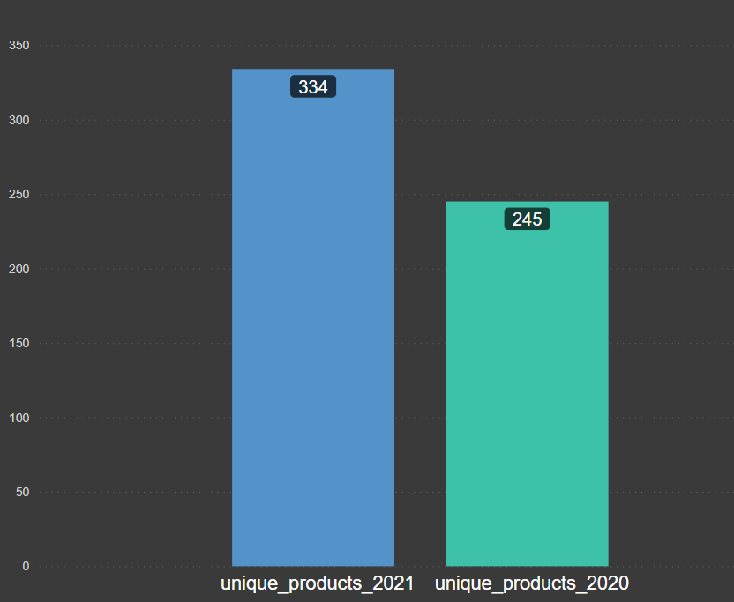
2.What is the percentage of unique product increase in 2021 vs. 2020?
There is 36.33% increase in product in 2021. 334 Products in 2021. 245 Products in 2020.

Slide 6
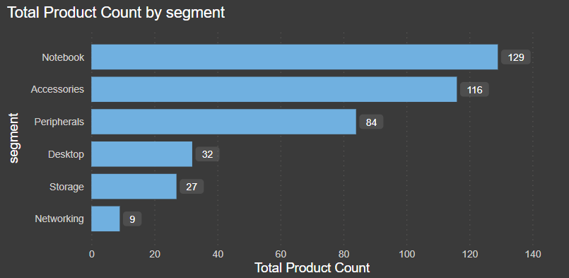
3.Provide a report with all the unique product counts for each segment.
The company operates across six distinct segments.
Notebook
Accessories
Peripherals
Desktop
Storage
Networking

Slide 7
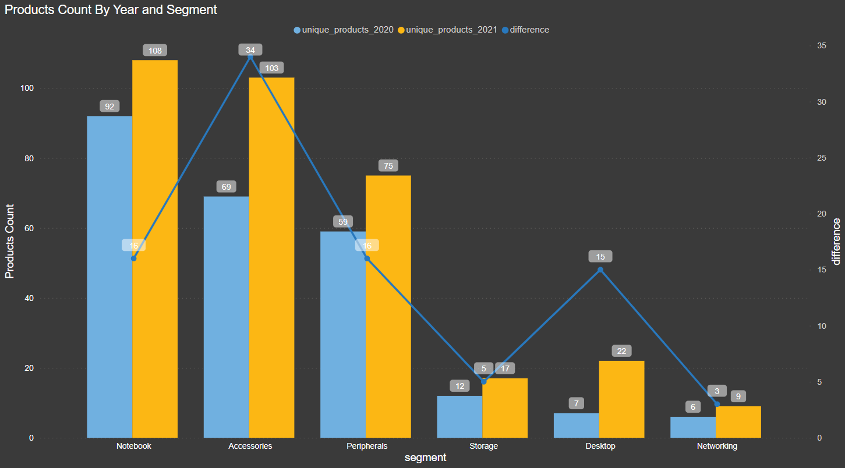
4.Which segment had the most increase in unique products in 2021 vs 2020?
The accessories segment saw the biggest surge in unique products in 2021 compared to 2020, with a remarkable 49.27% increase.

Slide 8


5.Get the products that have the highest and lowest manufacturing costs.
Highest manufacturing cost
Lowest manufacturing cost
product_code | product | manufacturing cost
A6120110206 | AQ HOME Allin1 Gen 2 | 240.5364
product_code | product | manufacturing cost
A2118150101 | AQ Master wired x1 Ms | 0.892

Slide 9
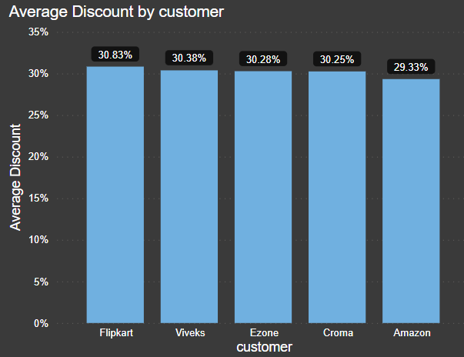
6.Generate a report which contains the top 5 customers who received an average high pre invoice discount percent for the fiscal year 2021 and in the Indian market.
In 2021, Flipkart enjoyed the highest pre-invoice discount advantage among its competitors, averaging a remarkable 30.83%.

Slide 10
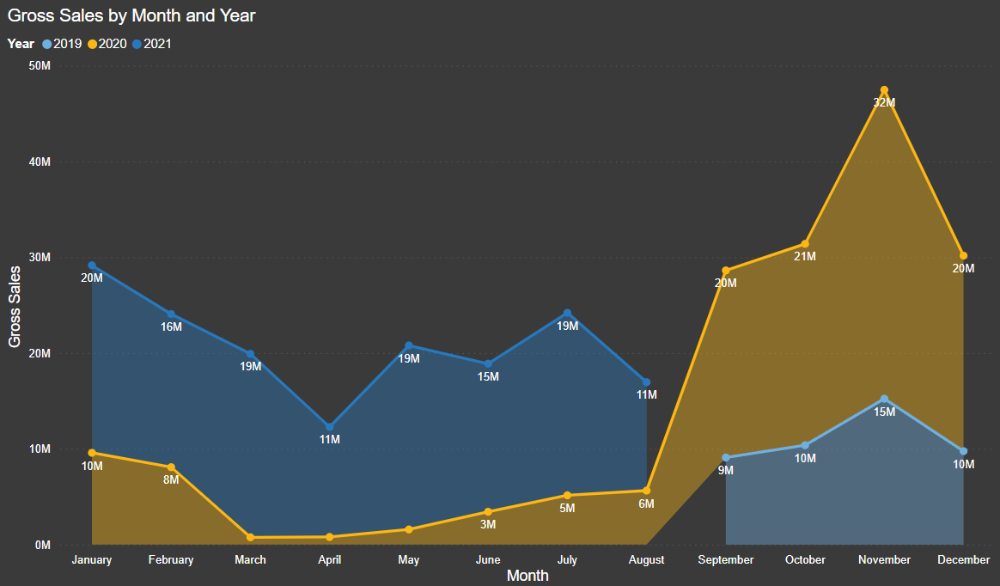
7.Get the complete report of the Gross sales amount for the customer “Atliq Exclusive” for each month.

Slide 11
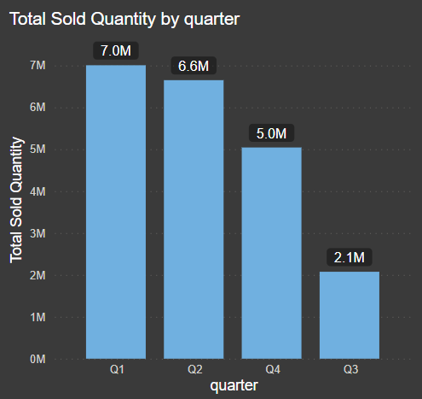
8.In which quarter of 2020, got the maximum total sold quantity ?
In Q1 2020, the company achieved robust sales, exceeding 7 million units.

Slide 12
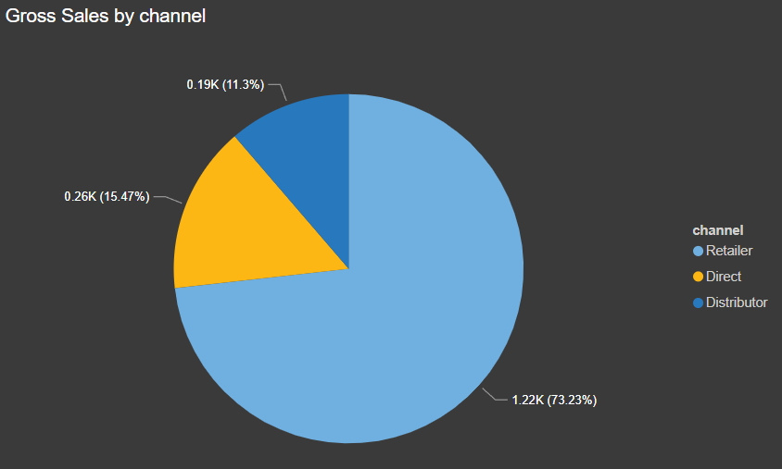
9.Which channel helped to bring more gross sales in the fiscal year 2021 and the percentage of contribution ?
Retailers led the charge in driving gross sales, contributing more than 7 out of 10 units (73.23%). The direct channel chipped in with one-quarter (25.47%), while distributors lagged behind with just over 10% (11.3%).

Slide 13
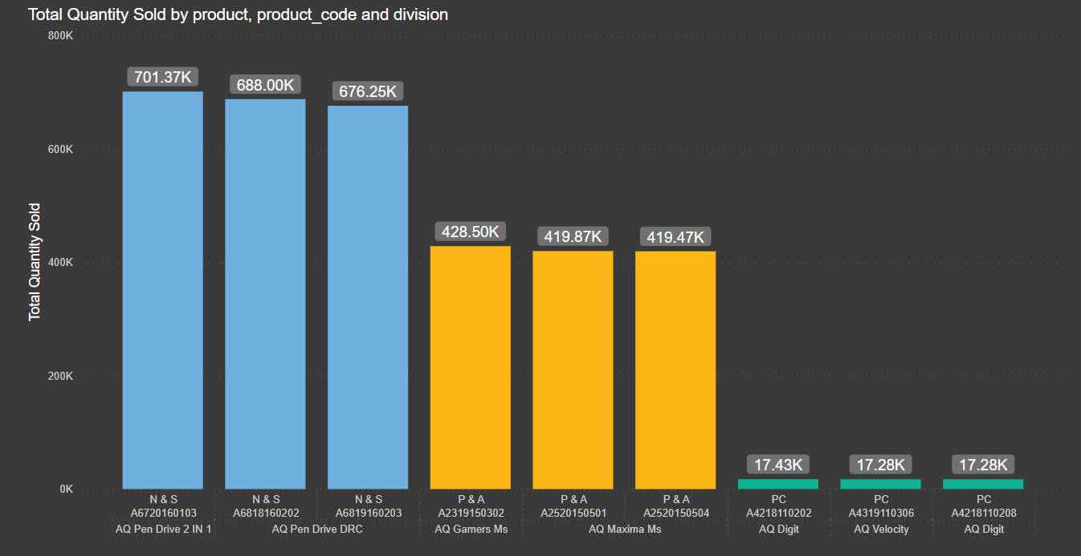
10.Get the Top 3 products in each division that have a high total sold quantity in the fiscal year 2021 ?
The N&S division witnessed overwhelming success with the Aq Pen Drive, achieving a remarkable 701,370 units sold. Similarly, the Aq mouse commanded dominance in the P&A division, with a captivating 428,500 units finding their way into consumers' hands. Even within the PC division, the Aq Digit maintained its top position, solidifying its presence with 17,340 units sold.

